Slide 1
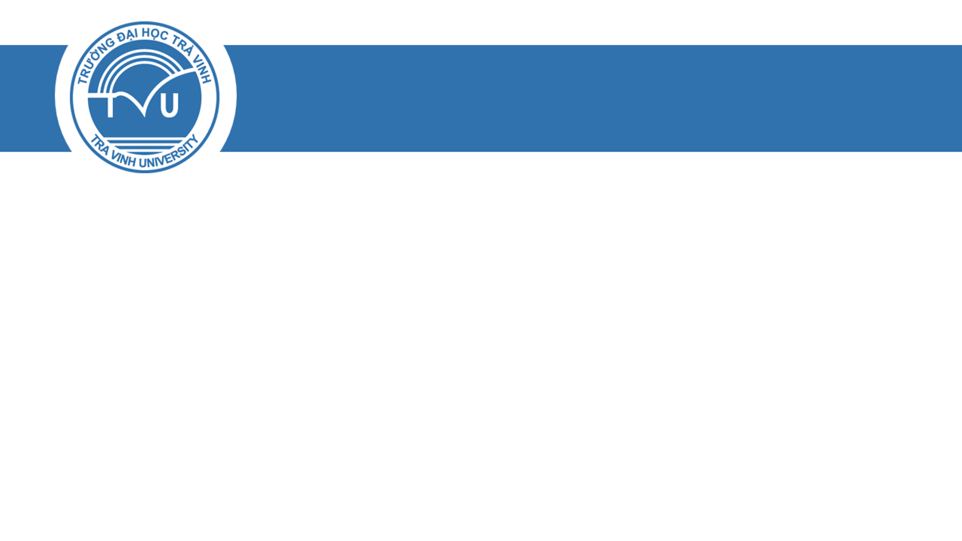
TRƯỜNG ĐẠI HỌC TRÀ VINH
KHOA KỸ THUẬT VÀ CÔNG NGHỆ
Social Network Analysis and Visualization of Arabic Tweets During the COVID-19 Pandemic
GVHD: TS. Nguyễn Nhứt Lam
Học viên thực hiện:
- Nguyễn Thị Quyên - 911222006
- Đỗ Thành Ý - 911222013
- Trần Quốc Tấn - 911222008
Trà Vinh – 09/2023

Slide 2
1
Introduction
2
The Proposed Method
3
Experimental Results
4
Findings and Discussion
5
Concluding Remarks

Slide 3
1. Introduction
Twitter data have been used widely in times of pandemics and crises. Consequently, people tend to share COVID-19-related content on social media extensively. As a new pandemic, only a small number of studies have been conducted to analyze COVID-19-related tweets, and even fewer were meant for Arabic tweets. This research explores the influence of the COVID-19 pandemic on Saudi users’ tweeting behavior. In particular, the research adopts a social network analysis (SNA) for COVID-19 Arabic tweets.
Based on 8905 collected Arabic tweets, this research resulted in three main contributions: 1) a visualization of the social network for COVID-19 tweets of Saudi users, 2) an identification of information sources that Twitter users employ during the COVID-19 pandemic, and 3) an identification of the most popular influencers among users of COVID-19 tweets.

Slide 4
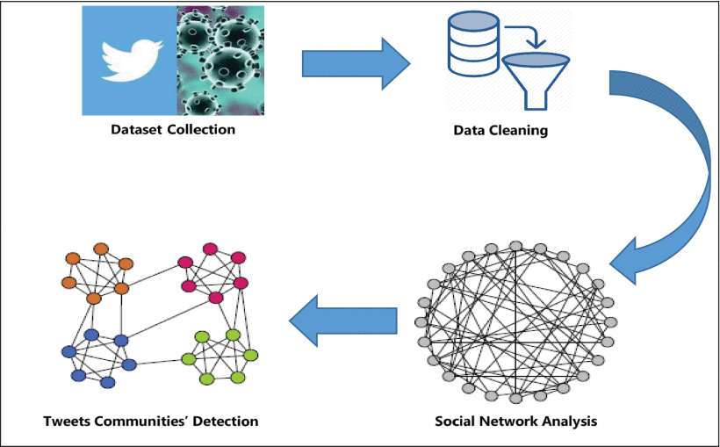
2. The Proposed Method
FIGURE 1

Slide 5
2. The Proposed Method
Analyzing Twitter data allows for understanding public behavioral responses, and longitudinal tracking allows for identifying changes in responses. By applying social net-working analysis for tweets about COVID-19, various infor-mative resources of tweets are identified. Moreover, people’s interest and awareness about COVID-19 can be detected.
The methodology of the current study consists of four main phases:
- dataset collection
- data cleaning
social net-work analysis
tweet community detection.

Slide 6
2. The Proposed Method
DATASET COLLECTION AND ANALYSIS
The dataset collection phase aims to obtain the raw data from Twitter to be used in the social network analysis process.
In this study, data was collected and analyzed using Gephi software (https://gephi.org). Gephi is an open-source and free visualization and exploration software for graphs and networks. It was used mainly in our study to collect the data, explore it, and apply the social network analysis.

Slide 7
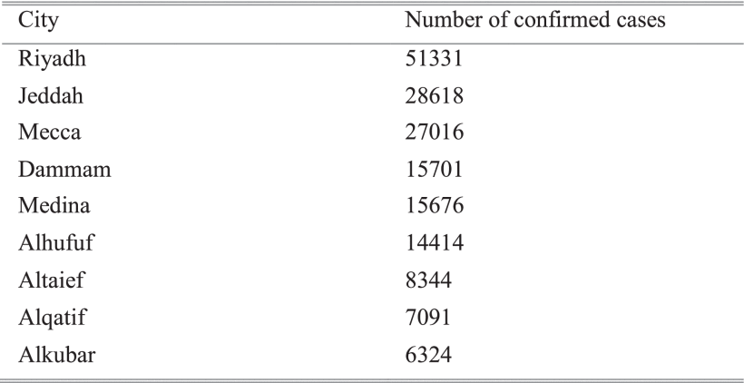
2. The Proposed Method
TABLE 2 The Number of Confirmed Cases in the Different Saudi Cities as of 07/18/2020

Slide 8
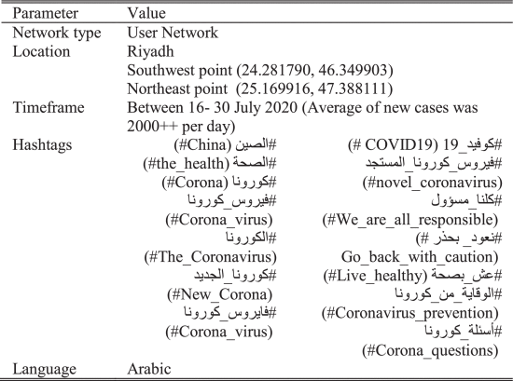
2. The Proposed Method
TABLE 3 Parameter Settings Used to Collect Tweets

Slide 9
2. The Proposed Method
B. Dataset Preprocessing
To be able to obtain accurate social network visualization, data preprocessing shall take place. Thus, after data were loaded into the Gephi environment, tweets were filtered, and unrelated tweets were excluded from the analysis.

Slide 10
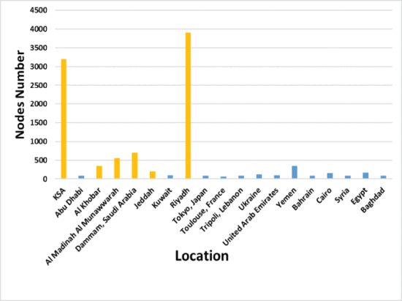
2. The Proposed Method
FIGURE 2.
Number nodes in the different locations. Only users who reside in Saudi Arabia were included (colored in yellow), while others were excluded from the analysis.

Slide 11
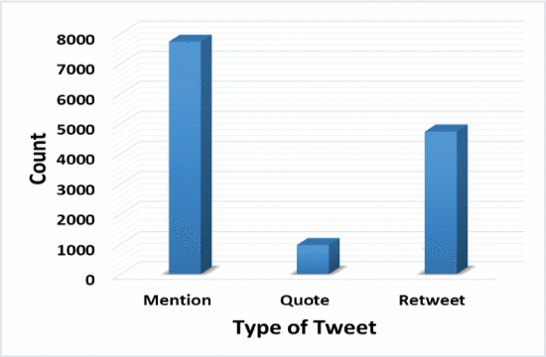
2. The Proposed Method
FIGURE 3.
Counts of tweet types. Mention tweets are the most common tweets followed by retweets.

Slide 12
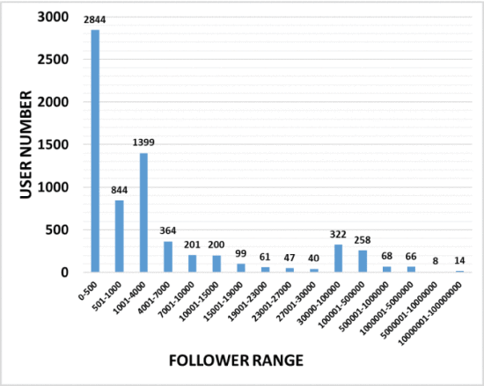
2. The Proposed Method
FIGURE 4.
Number range of user followers. Most of the users (approximately 2800 users) have less than 500 followers. Many of them (approximately 1400 users) have between 1001 and 4000 followers.

Slide 13
2. The Proposed Method
C. SOCIAL NETWORK ANALYSIS
One of the key characteristics of social network analysis is finding prominent and influential nodes in the social network. centrality measures are among the most commonly used indices based on network data.

Slide 14
2. The Proposed Method
D. TWEETS’ COMMUNITY DETECTION
Once the social network was visualized, tweet owners were clustered into several communities with similar characteristics and a stronger relationship. clauset, newman, and moore’s (cnm) method is one of the most important methods for community detection in networks, and, currently, it is one of the most studied methods for this purpose.

Slide 15
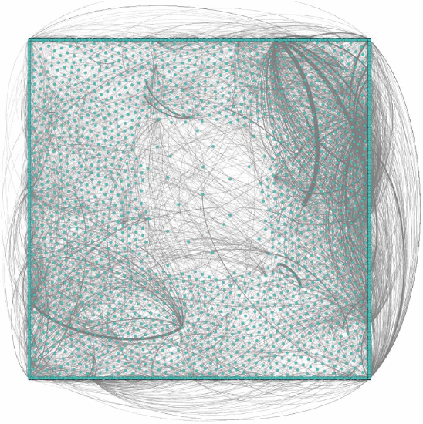
3. Experimental Results
A. Overview of the Network
FIGURE 6.
Preliminary overall social network structure of twitter users. The formed network shows the users and the interactions among them.

Slide 16
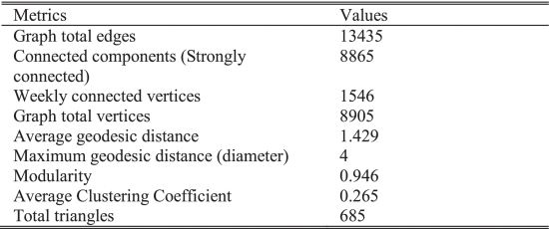
3. Experimental Results
TABLE 4 Overall Graph Metrics of Twitter Users

Slide 17
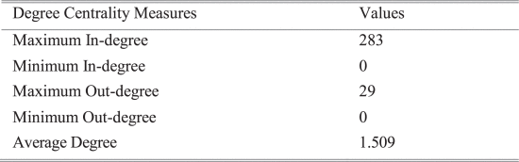
3. Experimental Results
B. Network Measures
1) In-Degree and Out-Degree Centrality Results
TABLE 5 Degree Overview of Twitter User Network

Slide 18
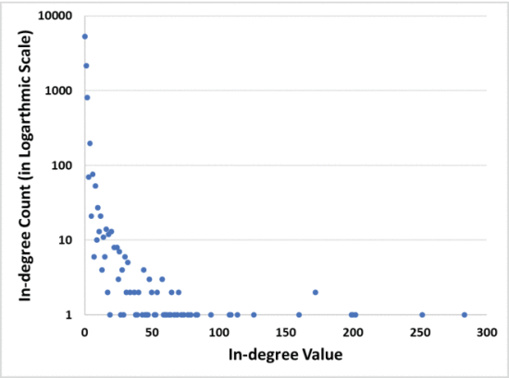
3. Experimental Results
FIGURE 7.
In-degree values and counts. Most of the nodes have a small number of in-degree values.

Slide 19
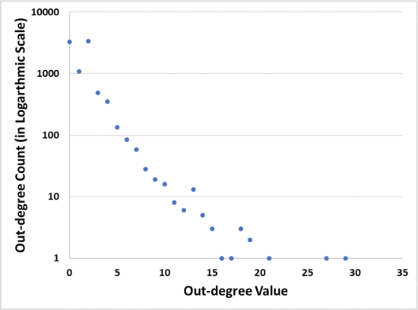
3. Experimental Results
FIGURE 8.
Out-degree values and counts. A noticeable number of nodes have small number of out-degree values.

Slide 20
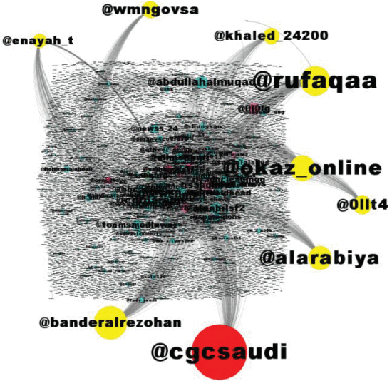
3. Experimental Results
FIGURE 9.
Over 100 in-degree users. The top three users are @cgcsaudi, @banderalrezohan, and @okaz_online.

Slide 21
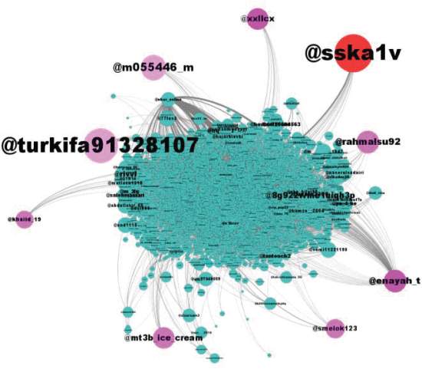
3. Experimental Results
FIGURE 10.
Over 15 out-degree user nodes. The top three users are @turkifa91328107, @sska1v, and @m055446_m.

Slide 22
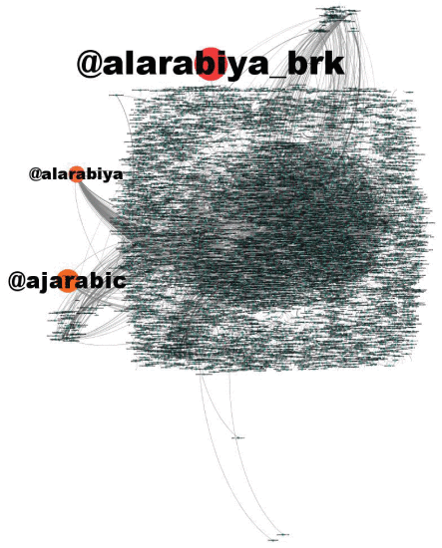
3. Experimental Results
2) Closeness Centrality Results
FIGURE 11.
op nodes with the lowest closeness rank (equal to 0) and highest friend count. The top three users are @alarabiya_brk, @ajarabic, and @alarabiya.

Slide 23
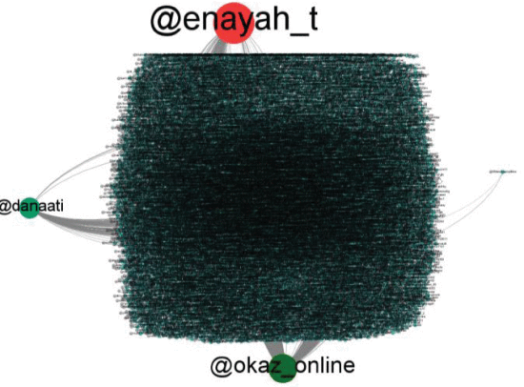
3. Experimental Results
3) Betweenness Centrality Results
FIGURE 12.
Top nodes with the highest betweenness values. The top three users are @enayah_t, @okaz, and @danaati.

Slide 24
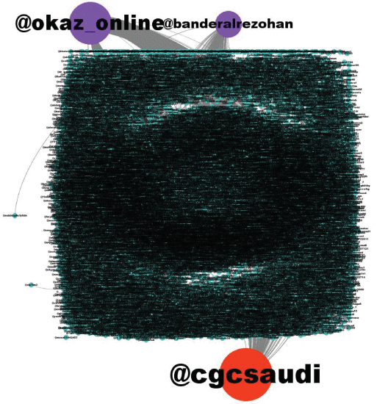
3. Experimental Results
4) Eigenvector Centrality Results
FIGURE 13.
Three top nodes with highest eigenvector centrality. The top three users are @cgcsaudi, @okaz, and @banderalrezohan.

Slide 25
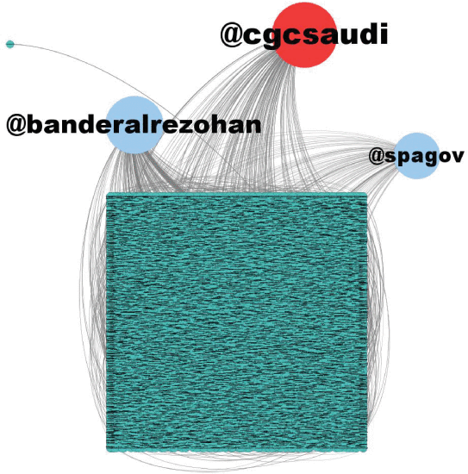
3. Experimental Results
5) Pagerank Results
FIGURE 14.
Top nodes with the highest pageRank values. The top three users are @cgcsaudi, @banderalrezohan, and @spagov.

Slide 26
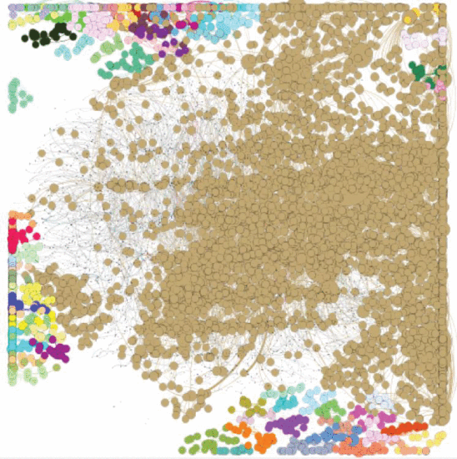
3. Experimental Results
C. Community Detection Visualization
FIGURE 15.
Network general communities. There is only one dominant cluster, highlighted in beige.

Slide 27
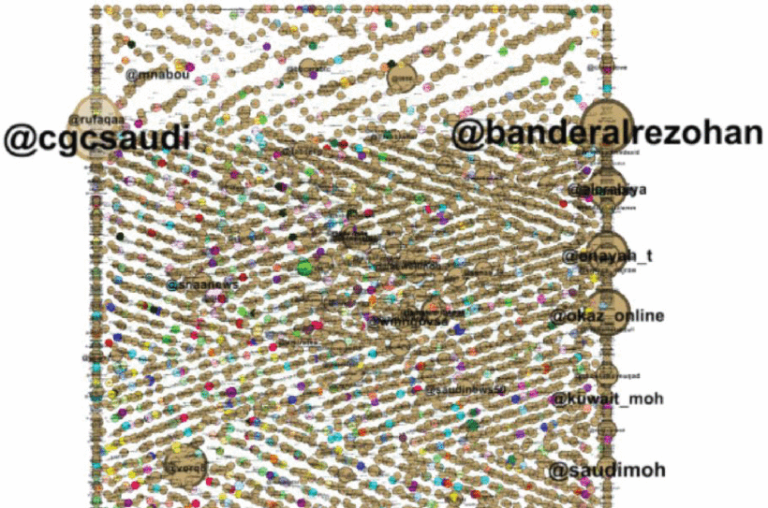
3. Experimental Results
FIGURE 16.
Network communities with pageRank. The dominant cluster contains all top influencers and information sources in the studied network.

Slide 28
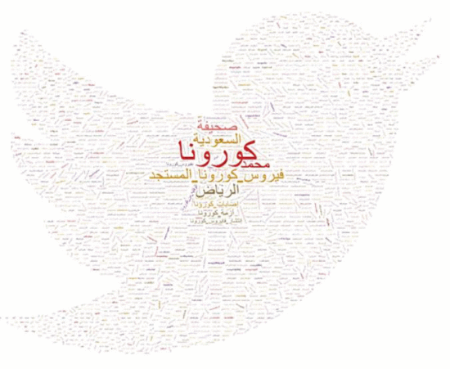
3. Experimental Results
D. Trend Analysis
FIGURE 17.
Overall Word cloud of the hashtag network. The most often mentioned hashtags are related to COVID-19 term.

Slide 29
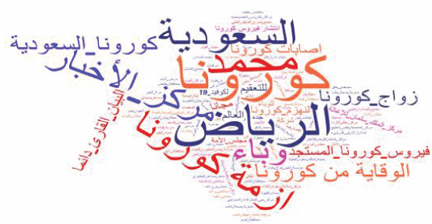
3. Experimental Results
FIGURE 18.
Word cloud of hashtags that have occurred multiple times. Beside COVID-19 hashtag, s ome words such as Riyadh “

Slide 30

4. Findings and Discussion
The information sources that Twitter users mostly referred to during the COVID-19 pandemic were: @cgcsaudi, @okaz_online, @alarabiya_brk, @ajarabic, @alarabiya, and @spagov.
The most popular influencers among COVID-19 Twitter users are @cgcsaudi, @banderalrezohan, and @okaz_online. As shown in Table 6, these were the common accounts among multiple network measures.
Based on community detection results, there are numerous miniclusters scattered around the social network. However, there is only one dominant cluster, highlighted in beige color (Fig. 16), and this cluster contains all top influencers and information sources in the studied network

Slide 31
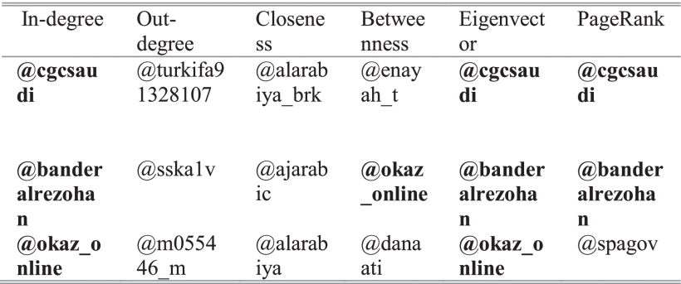
4. Findings and Discussion
31
TABLE 6 Top Influencers and Information Sources Based on the Different Measures

Slide 32
5.Concluding Remarks
32
Twitter has been a highly useful tool in healthcare for rapid information dissemination and acquisition during the COVID-19 pandemic. It helped researchers study the spread of the disease, find the latest information on COVID 19 and tweets from public health experts, and follow what is happening in real time during the pandemic. This study studied the influence of the COVID-19 pandemic on Saudi Twitter users’ tweeting behavior using social networking analysis (SNA).

Slide 33
5.Concluding Remarks
33
As Twitter influencers have a worldwide scope and access to different age sectors, the Saudi government may invest them in reducing the severity of COVID-19 and increasing the awareness of the disease consequences.
The analysis of the Twitter social network performed in this study can be used to anticipate the spread of the virus in Saudi Arabia
The government may make use of influential users in fighting outbreaks as their influence in tremendous domains and communities can help decision-making bodies.

Slide 34
34
Xin chân thành cám ơn

